Slide 1


Novelis Monthly Review July 2016

Slide 2
Agenda
Service Level Review
Service Level Attainment by Service Tower
Enterprise Architecture Review
Completed items
Open action items
Service Desk Review
Review of Operational Trends and Forecasting
Review of any Open Action Items
Deskside Review
Review of Operational Trends and Forecasting
Review of any Open Action Items
Base Services Review
Review of Operational Trends and Forecasting
Review of any Open Action Items
Cross Functional Services Review
Change Management
Continued Service Improvement
Problem Management
IT Asset Management
ServiceNow Support Review
ServiceNow Support
Quality Review
Overall
CSAT Response Rate
Knowledge Review
Ticket to KB ratio
Knowledge created / updated
Additional data Slides
Incidents
Global
By Service Group
Tasks
Global
By Service Group

Slide 3
Stefanini participants
Stefanini
Sal Maglio | Global Director, Service Delivery
Matt Sherock | Global Deskside Services Manager
James Chapman | Global Service Desk Manager
Don Dayandayan | Global Base Services Manager
Greg Cothran | Enterprise Architecture Manager
Ivan De Marchena | Project Manager – Service Now
Edison Valeng | Asset Manager
Dinno Cana | Change and Problem Manager

Slide 4

Service Desk
Service Level Review

Slide 5
Service Desk – Global Service Levels
Service Level Number / Description | Definition | Target | 2016 Jul | Weighting %
SD - Speed - 1 Speed to Answer - Telephone Calls | % of Calls Answered within 30 seconds | >= 80% | 93% | 20%
SD - Resolution - 1 Resolved on first Contact to SD (FCR) | % of Tickets Resolved by the same Service Desk Agent within 24 hours | >= 60% | Reporting Extension | 30%
SD - Resolution - 2 Resolved by SD without escalation (FTR) | % of Tickets Resolved within 48 hours without escalation to non-L1 groups | >= 65% | Reporting Extension | 30%
SD - Abandon - 1 Abandon Rate | % of Calls Abandoned | <= 3% | 2% | 20%
Service Level Number / Description | Definition | Target | 2016 Jul
SD - Speed - 2 Speed to Answer - Incident Self Service Tickets | % of Self-Service Tickets Answered within 4 hours | >= 95% | 90%
SD - Speed - Chat Speed to Answer - Service-Desk Chat | % of Service Desk Chat Answered within 2 minutes | >= 95% | 85%
SD - Processing - 2 Processing of LSA Incident Tickets | % of LSA Tickets Routed within 30 minutes | >= 95% | 100%
SD - Account - 3 Standard Account Admin (AD password reset) | % completion of all AD password reset within 15 minutes | >= 95% | 90%
SD - Account - 4 Expedited Account Admin (Suspension of Acct) | % completion of all Suspension of Account within 10 minutes | = 100% | no data
* New SLA burn in period through 1st of August
** re-calculation
Small Numbers Fairness

Slide 6
Deskside Global Service Levels
Service Level Number / Description | Definition | Target | 2016 Jul | Weighting %
Response-Platinum Response on Platinum Services | % of Tickets Responded related to Platinum users within 15 minutes | >= 99% | 97% 34/35 | 10%
Response-Gold Response on all Gold Service Location | % of Tickets Responded related to Gold Site Locations within 60 minutes | >= 90% | 97% | 1007 | 20%
Resolve-Gold-P2 - Urgent Resolution on P2 Gold Service Location | % of P2 Tickets Resolved related to Gold Site Locations within 3 hour | >= 92% | 92% | 25 | 20%
Resolve-Gold-P3 - Normal(A) Resolution on P3 Gold Service Location | % of P3 Tickets Resolved related to Gold Site Locations within 9 hour | >= 75% | 98% | 1006 | 40%
Resolve-Gold-P3 - Normal(B) Resolution on P3 Gold Service Location | % of P3 Tickets Resolved related to Gold Site Locations within 18 hour | >= 92% | 100% | 1006 | 35%
Service Level Number / Description | Definition | Target | 2016 Jul
Response-Dispatch Response on all Dispatch Location | % of Tickets Responded related to Dispatch Site Locations within 4 hours | >= 90% | 100%
Resolve-Platinum(A) Resolution on Platinum Services | % of Tickets Resolved related to Platinum users within 4 hours | >= 99% | 97% 34/35
Resolve-Platinum(B) Resolution on Platinum Services | % of Tickets Resolved related to Platinum users within 8 hours | = 100% | 97% 34/35
Resolve-Gold-P1 - Critical Resolution on P1 Gold Service Location | % of P1 Tickets Resolved related to Gold Site Locations within 1 hour | >= 92% | 100%
Resolve-Dispatch Resolution on all Dispatch Location | % of Tickets Resolved related to Dispatch Site Locations within 8 hours | >= 90% | 89% 32/36
IMAC-1 Standard Request for all Service Locations | % of Standard request completed within 3 days | >= 90% | 100%
IMAC-3 Expedited Request for EUC Hard IMACs | % of Expedited request completed within 9 hours | >= 90% | no data
Small Numbers Fairness

Slide 7
Base Services
Critical Service Level Number / Description | Definition | Target | 2016 May | Weighting %
SP - 3 Packaging of Standard Software Packages | % of packages completed within 10 business days | >= 80% | 100% | 5%
P - Patch - 1 Critical Patches deployed | % deployed approved patches within 12 days | >= 95% | no data | 10%
P - Patch - 3 Standard Patches deployed | % deployed approved patches within 21 days | >= 95% | 100% | 10%
Service Level Number / Description | Definition | Target | 2016 May
INC-Respond-1 Response on Incident Tickets(Extensive) | % of Incident Tickets Responded within 15 minutes (Global/Extensive) | >= 90% | 100%
INC-Respond-2 Response on Incident Tickets(Significant) | % of Incident Tickets Responded within 30 minutes (Significant/Large) | >= 90% | 82% 27 achieved out of 33 tickets
INC-Respond-3 Response on Incident Tickets(Moderate) | % of Incident Tickets Responded within 60 minutes (Moderate/Limited) | >= 90% | 84% 376 achieved out of 445 tickets
INC-Resolve-1 Response on Incident Tickets(Extensive) | % of Incident Tickets Resolve within 8 hours (Global/Extensive) | >= 90% | 100%
INC-Resolve-2 Response on Incident Tickets(Significant) | % of Incident Tickets Resolve within 16 hours (Significant/Large) | >= 90% | 100%
INC-Resolve-3 Response on Incident Tickets(Moderate) | % of Incident Tickets Resolve 24 hours (Moderate/Limited) | >= 90% | 98%
- no data – means no tickets fall on SLA criteria for the reporting month

Slide 8
Base Services
Service Level Number / Description | Definition | Target | 2016 May
Requested Item - 1 Completion of requested TASK | % completion of Requested Task within 15 minutes | >= 90% | no data
Requested Item - 2 Completion of requested TASK | % completion of Requested Task within 4 hours | >= 90% | 95%
Requested Item - 3 Completion of requested TASK | % completion of Requested Task within 8 hours | >= 90% | 94%
Requested Item - 4 Completion of requested TASK | % completion of Requested Task within 2 days | >= 90% | no data
Requested Item - 5 Completion of requested TASK | % completion of Requested Task within 4 days | >= 90% | 100%
Requested Item - 6 Completion of requested TASK | % completion of Requested Task within 10 days | >= 90% | no data
- no data – means no tickets fall on SLA criteria for the reporting month

Slide 9
Enterprise Architecture
Enterprise Architecture Review

Slide 10
Enterprise Architecture
Successes
Dashboard for security applications went live. http://novsccmcas00/security.html DC/DHCP COOP New Tech Writer job description developed and submitted for sourcing.
Open Action Items
Documentation for open SOW Deliverables (Patch Management / Release Deploy / SDLC) – Team formalized and outline being drafted. MBAM 256-bit standard across Novelis OneDrive for Business – developing 2 solutions (new and current devices). Auto-populate AD Groups – Requested by HR through SharePoint team. Solution being tested now. AD Security Assessment Remediation – Tasks created and tracked on SharePoint. Windows 10 – Testing deployment methods. Assisted with Global SAP Audit SharePoint site.

Slide 11
Service Desk
Service Desk Review

Slide 12
Service Desk
Service Desk
Successes
Helsinki User Acceptance Testing (UAT) – Assisted on Helsinki testing in ServiceNow Shift Left Updates: Phishing Email Ticket Handling Process – Knowledge finalized and training initiated in July, currently the SD is working tickets assigned to the IT Service Desk PhishMe L1. Volume Q3:
SLA Review
SD - Abandon - 1– Our Abandon Rate is low across all regions; significant improvement over 2015. SD - Speed – Chat – Chat response still challenging for SD, July is the last month for burn-in period. SD – Resolution (1 & 2) – Service Now dashboard for SD resolution 1 and 2 still not working properly due to limitations of SNOW out of box SLA reporting module. Script, created by Stefanini to be reviewed with Novelis and moved to production by EOM.
Updates and On-going Actions
Regional CSAT Improvement Project – Stefanini to create action item plan. IC Dashboard – Dashboard completed uploaded regularly to Novelis SharePoint: IC Dashboard SharePoint link GreenShot – GreenShot software now available as a replacement for SnagIT; five self help KBs created for end users. ODfB – Knowledge Team created 9 KBs and training delivered to all service desk agents globally.

Slide 13
Deskside
Deskside Review

Slide 14
Deskside
Successes
Deskside Agent annual refresher training: Deskside team has completed annual refresher training. ODfB training– Deskside team has completed the ODfB training. NIC Issues – Deskside performed multiple tests and re-tests globally in conjunction with the SCCM, Dell and John Pezzino. We have determined that the intermittent issues with the NIC cards are not due to a the SCCM image or faulty hardware.
Open Action Items
Vietnam Deskside Support: Vietnam has contracted local Deskside support for their plant. Dell Laptop NIC Issues - Warren Ohio: David Priest is still reporting intermittent issues with the NIC cards in the 7000 series laptops. Application Packaging: The team has met with Bruce and Don for training testing and are currently performing additional testing. Training Rooms Atlanta – The team is working with Clemens and Carol to have the conference rooms in Atlanta updated and modernized to meet Novelis needs. Local Training Sessions: Deskside is working on compiling lunch and learn type training session for End Users. We are targeting to take this live by end of August.
Staffing
Atlanta: Keenon Snow has been brought in to the Atlanta Deskside Support team. Terra Haute: Jared Bush has been brought in as a temporary solution as the EUC IT support team member. Ohle: Martin Rissman has successfully returned from medical.

Slide 15
Base Services
Base Services Review

Slide 16
Base Services
Successes
HTTPS mobile access: Base Services has provided the solution for F5 proxy locations. Certificate roll-out and whitelisting of a site if needed. Symantec VIP Authentication Service: Migration of SSL Certificates to SHA-2 New Certificate Authority Servers setup and configuration: 4 New CA Servers with 2012 R2 OS to support SHA-2 algorithm. PhishMe Operational and Process shift to Stefanini: The initial filtering of the PhishMe tickets are now handled by Stefanini through a separate queue. Process has been built on how to handle each and every ticket. Domain Controller and DHCP Failover setup in NA: Completed with Yeongju, Ulsan, China, Malaysia and Vietnam sites. Dell Custom Factory Integration (CFI) / Factory Image: Ordered units were deployed and KB has been published.
Open Action Items
AD Cleanup in NE: Done with Goettingen, Nachterstedt, Stuttgart and Latchford. Approved cleanup document for Wednesbury, Madeira, Crick and West Brom and scheduled Change to be implemented August 19, 2016. OneDrive for Business (ODfB): IT-Users Deployment is in schedule. ProofPoint Project Assistance: Proof of Concept planning and implementation for Novelis’ email filtering POC. 2 New SCCM Secondary Site Server Migration for NSA: Have accomplished the setup and configuration awaiting replication across the primary site. GPO Cleanup / AD Cleanup: Ongoing efforts of Stefanini Base Services with Novelis’ Security Team.
Staffing
Active Directory: Level 3 resource filling in progress.

Slide 17
Change Management
Cross-Functional Service Review

Slide 18
Change Management
 | Normal | Exception | Emergency | Standard | Total
July EOM | 20 | 2 | 0 | 3 | 25

Slide 19
Change Management
Successes
No change backlogs have been recorded for the month. Volume of Exception changes has maintained at a manageable level with low volume percentage for the month. ServiceNow Change Management enhancements – successfully completed - The Change management enhancements in ServiceNow has been successfully deployed to production.
Challenges
Issues with Change Module due to enhancements. - After the change module enhancements have been deployed to production, there were issues with the already existing change records. However we were able to work on a fix and successfully deployed in production and working now as expected.

Slide 20
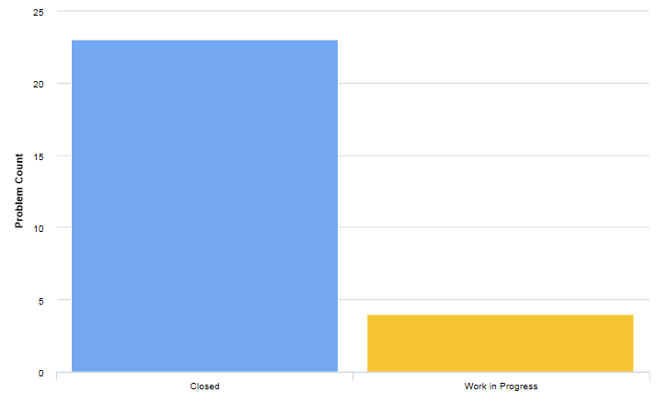
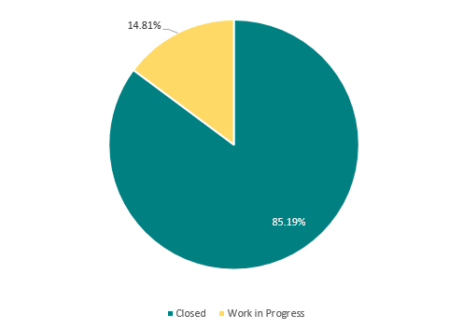
Problem Management
Total volume of problems registered last July and current status
Percentage of successful major problem reviews

Slide 21
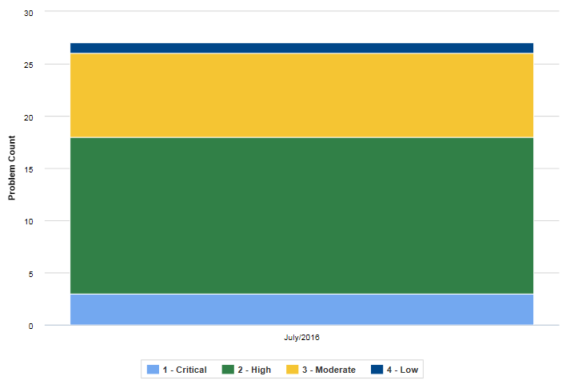
Problem Management
Problem tickets according to Priority

Slide 22
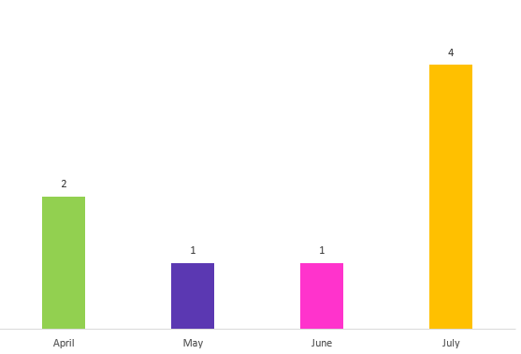
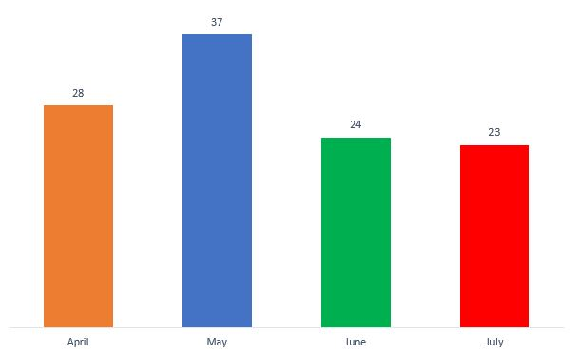
Outstanding and Successfully Closed Problem Tickets
The following Problem tickets are pending for RCA from the Problem ticket owners:
PRB004203
- FMA_Q2_2016_R2R_Preventive_User Training Issue
PRB0042028
- Kingston \ SAP PGE \ Mill Certs are not printing from SAP
PRB0042010
- SAP Batch field not getting updated on SI IBDs created against Consignment Pos
PRB0041992
- Error when updating purchase orders
Capgemini-SAP remains the top initiator of Problem tickets. Most coming from the IT APP Global SAP TECH L2 and IT APP Global SAP P2S SCE L2 resolver groups.
Common driver of Problem tickets: Issue on ingots.

Slide 23
Problem Management
Successes
23 out of 27 Problem tickets were resolved. Problem tickets continue to have complete information most of the time which shows the familiarity of the problem owners with the requirements of the process.
Challenges
Observed that the Escalation Matrix in Problem Management has not been familiar to some problem owners, thus the Problem Management team needs to remind them of the correct process.

Slide 24
Asset Management
Asset Management Review

Slide 25
Asset Management
Successes
July Refresh Completed for NNA and NE: The next refresh cycle for these two regions is slated for October 2016.
Open Action Items
NA Renewals for FY 2017: Currently renewals are pending at this time. There is a staggered renewal schedule for the upcoming fiscal year. Functional Hardware Asset Lifecycle: The demo and roll out of the work packages have been delayed due to a conflict of the working scripts from Fuji to Helsinki – it is now scheduled for the 29th of August. Software Asset Management: Discussion and planning of project is still with Flexera and SoftwareOne. The Stefanini Asset Management team is participating with the current discussions and providing information and insight as needed.
Challenges
ServiceNow Inventory: Inventory for Gold sites will start on August 2016 to verify the computers currently marked in stock within ServiceNow. ServiceNow Remediation: Due to the delay and complications on the work packages there is a delay on providing the comparison between active and inactive CI’s to the states of the Asset Records.

Slide 26
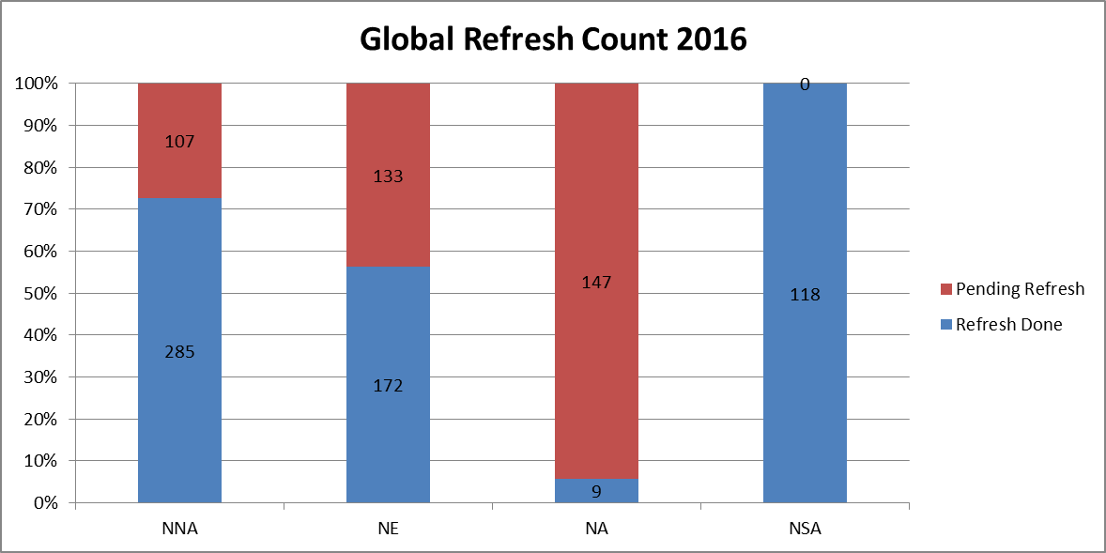
Asset Management
NA Renewals are pending for Fiscal Year 2017.
NNA and NE July Refresh has concluded and the October 2016 refresh has begun this August.

Slide 27
Asset Management
Service Now Review

Slide 28
Service Now – Ongoing tasks and progress progress
Row Labels | IMPLEMENTED TO PROD | WORK IN PROGRESS | DEV DONE / FOR TESTING | Grand Total
MAY | 44 | 54 |  | 98
DFCT |  | 7 |  | 7
INC | 40 | 47 |  | 87
TASK | 4 |  |  | 4
JUN | 42 | 49 | 1 | 92
DFCT |  | 6 | 1 | 7
INC | 38 | 43 |  | 81
TASK | 4 |  |  | 4
JUL | 55 | 44 |  | 99
INC | 55 | 44 |  | 99
Grand Total | 141 | 147 | 1 | 289

Slide 29
ServiceNow Updates
In Progress
Helsinki upgrade: Scheduled for August 18th SLA Definitions: Ongoing Employee to Contractor development: In final development stages
Completed
ServiceNow System Administrator: started August 1st ServiceNow L2 Support: Over 30 tickets in the queue closed since JT (Julius Tondo) joined the team

Slide 30
Project Management / ServiceNow Support
Quality Review

Slide 31
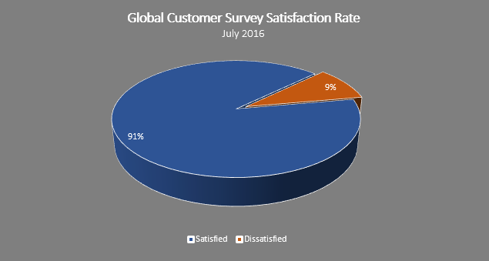
Service Desk
Quality – Overall Satisfaction
Highlights:
Surveys Offered: 3061
Global Responses: 95 total, 86 positive, 9 negative
Global Response Rate: 4.96% for July

Slide 32
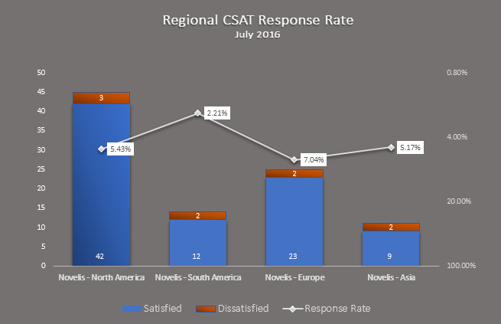
Service Desk
Quality – CSAT Response Rates

Slide 33
Project Management / ServiceNow Support
Knowledge Support Review

Slide 34
Service Desk
Knowledge – Ticket to KB ratio
Highlights:
All regions show improvement of ticket to KB ratio from May to July; primary driver due to KCS up-training and new Quality Components
Small decrease in overall volume for July, no specific drivers identified

Slide 35
Service Desk
Knowledge – Updated and Created
Highlights:
Update steady from June to July
Drivers for June Knowledge Creation Spike:
inTune
MS Business Intelligence
5 Deskside technicians trained on Knowledge Based authoring

Slide 36
Project Management / ServiceNow Support
Additional Data Slides

Slide 37
Incident by Contact Type (Global View)

Slide 38
Incident by Contact Type (Service Desk)

Slide 39
Incident by Contact Type (Deskside)

Slide 40
Incident by Contact Type (Base Services)

Slide 41
Task by Region (Global View)

Slide 42
Task by Region (Service Desk)

Slide 43
Task by Region (Deskside)

Slide 44
Task by Region (Base Services)

Slide 45


